Slide 1

ONLINE
BAKING
APPLICATION
www.websiteexample.com
Notes:
Links:
https://www.pexels.com/photo/black-sail-ship-on-body-of-water-906982/

Slide 2
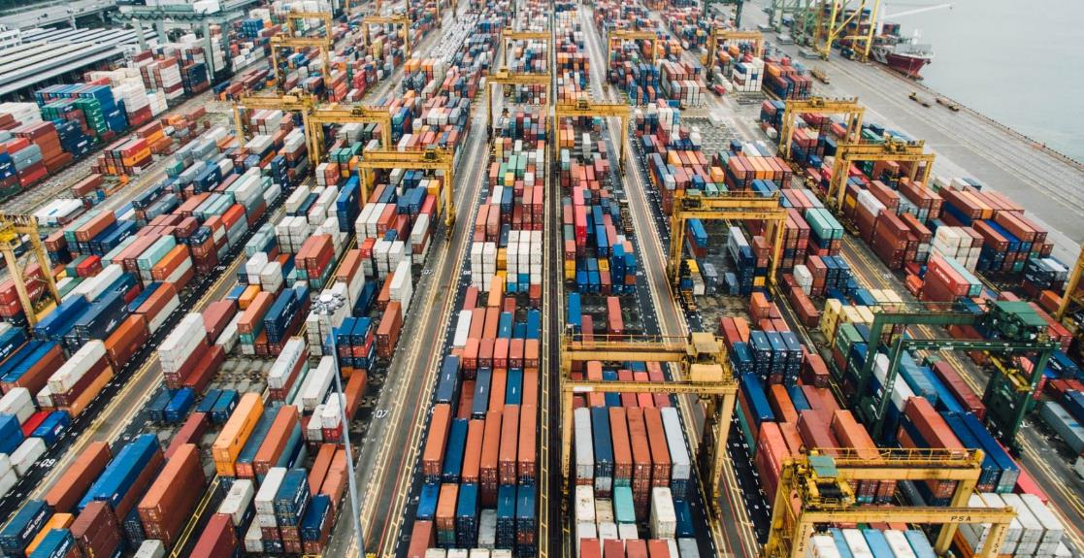


Our Mission
Our Vision
We aim to provide a user-friendly platform where individuals can manage their financial transactions efficiently and securely.
We strive to create seamless, secure, and accessible financial services that meet modern banking needs and contribute to the evolution of digital banking.
Notes:
Links:
https://unsplash.com/photos/fN603qcEA7g

Slide 3
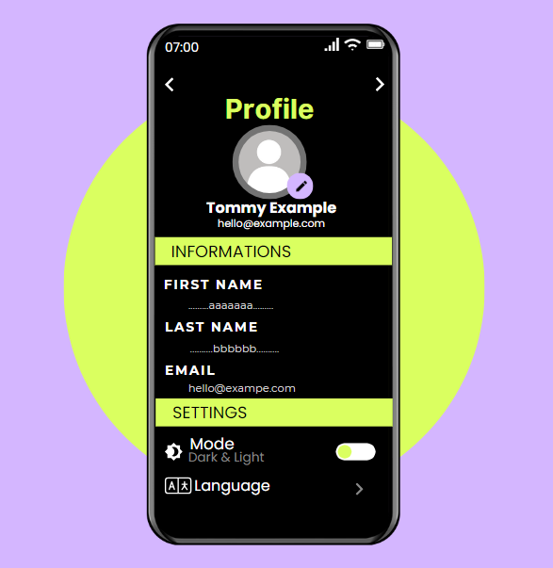
ABOUT US
Get to know us better
We are a team of students form the Department of Computer Science & Information Technology at Njala University, Sierra Leone. As part of our project work, under the guidance of our tutor, we designed and implemented an Online Banking Application. This project demonstrates our knowledge of object-oriented programming (OOP) and the use of advanced data structures and algorithms. The goal of our project is to develop a secure, efficient, and user-friendly plant form for managing various banking operations, such as account creation, fund transfers, and interest calculations.
Notes:
Links:
https://www.pexels.com/photo/assorted-color-trailer-boxes-2881632/

Slide 4




Project Objectives
Aim
Develop a user-friendly online banking system
Provide secure login and user authentication
OBJECTIVES
Online Banking Application
This project aims to develop an Online Banking System that offers a secure and user-friendly platform for users to perform various banking transactions.
Scope
Significance
Enable transactions: deposits, withdrawals, transfers
Implement interest rate and compound interest calculations
Notes:
Links:
https://www.pexels.com/photo/cargo-container-lot-906494/

Slide 5

FEATURES
User Registration (Sign up)
Login & PIN Recovery
Deposit and Withdraw Money
Transfer Money between accounts
Check Balance Inquiries
Interest Rate and Compound Interest Calculation
Notes:
https://www.pexels.com/photo/man-in-bubble-jacket-holding-tablet-computer-4484078/

Slide 6



Technology Used
Python
Visual Studio Code
Math Library
(Programming Language)
IDE

Slide 7
Development
Setup Environment:
Python Installation & IDE Setup:
  Installed the latest Python version and VS Code with Python extensions.
  Created project directory and virtual environment.
  Initialized Git, installed dependencies and verified setup with simple script.
  Configured testing framework (Unit test/pytest).
Data Structures:
  Dictionary: Storing user information efficiently.
  Future use of Lists, Stacks, Queues, Trees, and Graphs for more features.
Classes & Objects:
OOP Principles:
  Classes: The Banking System class handles banking functionalities.
  Objects: The instance of the Banking System interacts with the system.
  Encapsulation: Methods like registering user, login, deposit, etc.
  Abstraction: Hides the complexity of hashing and data storage.
Algorithms:
  Hashing: SHA-256 for secure PIN storage.
  Interest Calculations: Implements simple and compound interest algorithms.
  Future complex algorithms: Sorting transactions and user searches.

Slide 8
References
Python.org. (n.d.). Python Documentation. Retrieved from https://docs.python.org
Fowler, M. (2004). UML Distilled: A Brief Guide to the Standard Object Modeling Language (3rd ed.). Addison-Wesley.
Math Library Documentation. (n.d.). Python Standard Library Documentation. Retrieved from https://docs.python.org/3/library/math.html
Downey, A. (2015). Think Python: How to Think Like a Computer Scientist (2nd ed.). O’Reilly Media.
ISO/IEC 27001:2013. (n.d.). Information security management standards. International Organization for Standardization.

Slide 9
Conclusion
The Online Banking Application integrates essential banking functionalities into a secure, user-friendly system. By leveraging Python and implementing OOP principles, the project demonstrates a practical application of advanced data structures and algorithms.
Notes:
https://www.pexels.com/photo/man-in-bubble-jacket-holding-tablet-computer-4484078/

Slide 10
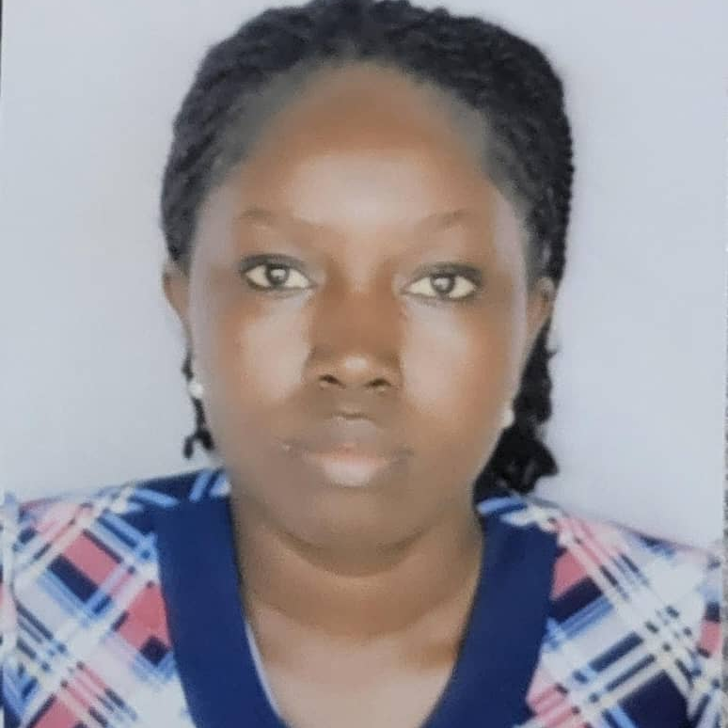

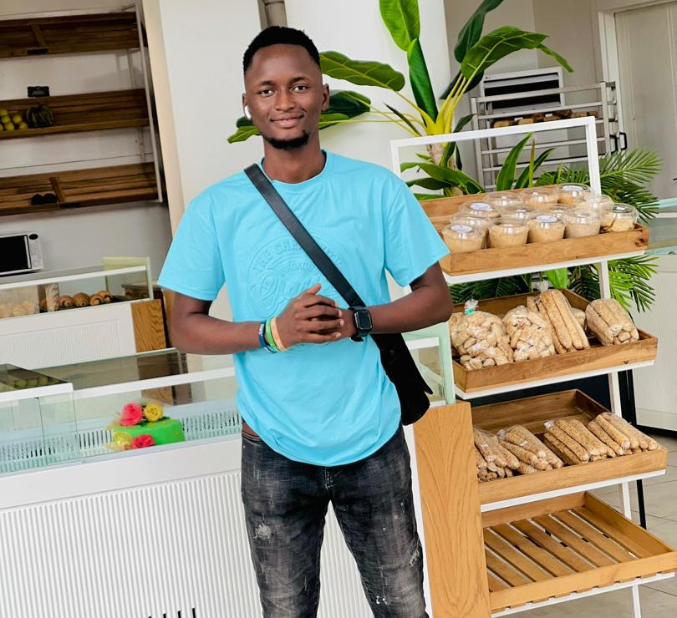

MEET OUR TEAM
Notes:
Links:
https://www.pexels.com/photo/men-s-wearing-black-suit-jacket-and-pants-937481/
https://www.pexels.com/photo/business-businessman-contemporary-corporate-532220/
https://www.pexels.com/photo/happy-ethnic-woman-sitting-at-table-with-laptop-3769021/
https://www.pexels.com/photo/cheerful-woman-smiling-while-sitting-at-table-with-laptop-4467687/

Slide 11

Thank You!
Tommy Daniel Tucker: ID.: 19545
Abu Junior Vandi: ID.:82937
Joshua Joe Harding: ID.: 19418
Hawanatu Kabba Bangura: ID.: 55072
Notes:
Links:
https://www.pexels.com/photo/black-sail-ship-on-body-of-water-906982/

